Slide 1
The Universal Grammar Approach: UG
Noam
Chomsky
MARMARA UNIVERSITY
DEPARTMANT OF ELT
MA PROGRAMME
Second Language Acqusition
Submitted to Assist.Prof. Dr. Zeynep Çamlıbel-Acar
Submitted by Buket Demirbüken
Fall 2013, İstanbul

Slide 2
Introduction
What is a linguistic theory?
Descriptive adequacy Explanatory adequacy
( to characterize what human languages ( to explain why they are that way)
are like )
Universal Grammar is therefore a proper theory as it explains the underlying linguistic knowledge in second-language learners’ minds
Linguistic Theory

Slide 3
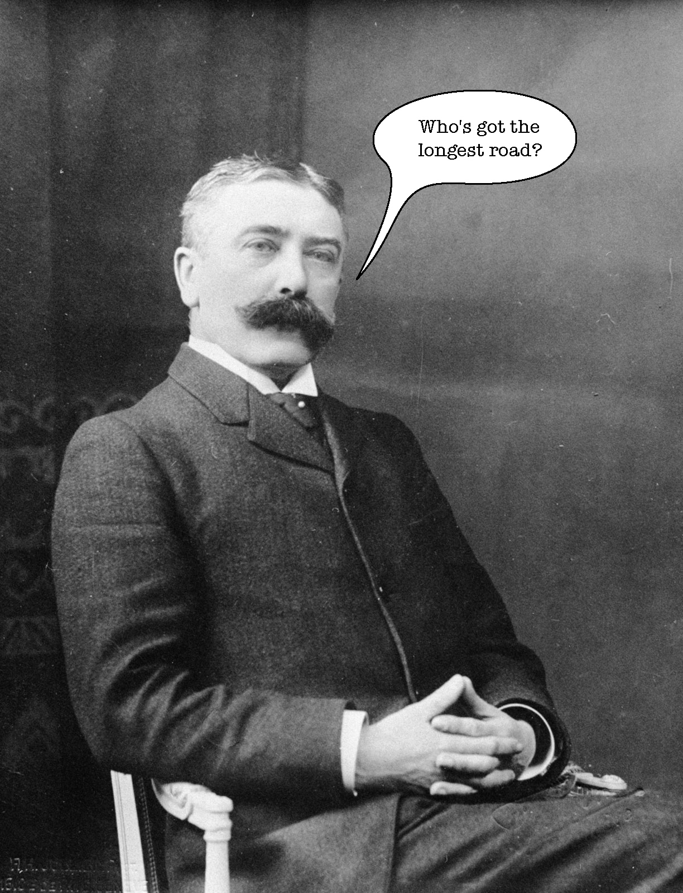
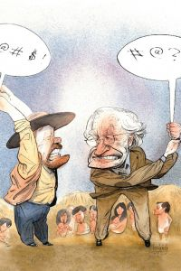
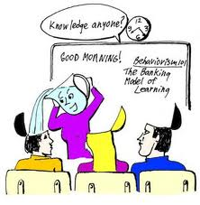
Background
1950s
late 1950s and early 1960s
1960s
Structuralism
Ferdinand de Seassure
Behaviourism
Skinner
Stimulus –Response Reinforcement
« Conditioning
Universal Grammar UG
Noam
Chomsky
»

Slide 4
Aims of linguistic researches
To answer;
What constitutes knowledge of language?
How is knowledge of language acquired?
How is knowledge of language put to use?
* Knowledge of language : subconscious mental representation of language that underlines all language use.
Chomsky added ; What are the physical mechanisms that serve as the material basis for this system of knowledge and for the use of this knowledge? ( concern of brain scientists)

Slide 5
What is UG?
Noam Chomsky claims that all languages have a common underlying system and all human beings inherit a universal set of principles that provide SLLs to acquire L2 as they acquire their native language with the help of an acquisition device that is UG.
Much of unconscious knowledge of grammar
( abstract linguistic system )does not need to be learned
in the course of L1 acquisition as it derives from UG.
The focus is on what is universal within this mind

Slide 6
UG arguments from L1 acquisition
UG arguments from L2 acquisition
Principles and Parameters
UG access Hypotheses
Parameter setting Hypotheses

Slide 7
UG Arguments from L1 acquisition
Main characteristics of L1 acquisition;
Children go through developmental stages
These stages are very similar across children although the rate differs
These stages are similar across languages
Rule governed and systematic
Children are resistant to correction
Children’s processing capacity limits the number of rules they can apply at any time and they will revert to earlier hypothesis when two or more rules compete.

Slide 8
These characteristics of L1 acqusition are similar to L2 acquisition characteristics , hence Universalists could not conclude the evidence that there is a langugae module in the brain out of it.
However, it is clear that child language acquisiton has nothing with intelligence.

Slide 9
a. John saw himself
b. * Himself John saw
c.Looking after himself bores John
d.*John said that Fred liked himself
e.*John told Bill to wash himself
f. John believes himself to be intelligent
g.* John believes that himself is intelligent
These sentences show that children deal with a difficult task to arrive at correct rule.
Children with cognitive deficits achieve it
Broca’s aphasia and Wernicke’s aphasia
Specific language impairment (SLI)
Examples

Slide 10
It shows that specific areas of brain deal with specific aspects of language and that suffering from a language deficit does not mean having lost language completely.
All this evidence make universalists claim that there must be a kind of innate language faculty that is biologically triggered . As language in children seems to grow in the same way a teeth develop or children start walking .

Slide 11
More evidence for language specific module in brain by Lenneberg’s criteria
The behaviour emerges before it is necessary
Its appearance is not the result of a conscious decision
Its emergence is not triggered by external events
Direct teaching and intensive practice have relatively little effect
Children go through well-defined stages ‘ milestones’
‘critical period’ – controversial issue

Slide 12
Principles and Parameters
UG approach claims that there is a universal set of principles and parameters that control the shape of human languages .
Principles Paramaters
-unvarying -possess a limited
-applicable to all number of open
natural languages values
Goverment & Binding Theory
Language

Slide 13
We can not apply the same structure to all languages although the principles are the same. The reason of it is that languages not only have PRINCIPLES but also PARAMETERS.
Parameters decide and limit the way in which sth can be done.

Slide 14
Minimalist Programme of Chomsky
Chomsky argues that the core of human language is lexicon.
In Minimalist programme , parametic variation occur within functional category such as various word order, morphology, determiners, auxilirias..etc
Abstract principles underlying all languages will already be specified in the computational module , children and SLLs is facing the task of learning lexicon of the language as well as the settings of parameters.
Lexical
categories
( content words)
Lexicon
Functional
categories
( grammatical
words)

Slide 15
Principles
Structure Dependency : Language is organized in such a way that it crucially depends on the structural relationships between elements in a sentence.
Words are regrouped into higher-level structures
which is based on a hierarchical structure.

Slide 16
Ex: My friend bought a new car yesterday.
The friend that I met in Australia last year bought a new car yesterday.
The friend I am closest to and who was so supportive when I lost my job two years ago bought a new car yesterday.
The same kind of groupings perform the same role in the sentence. We know that the crucial word is
‘ friend’ or ‘ she ‘
This kind of grouping is called as ‘ Phrase ‘ such as NP ( noun phrase), VP (verb phrase), AP, PP according to the head ( main element) of the phrase.

Slide 17
Your cat is friendly .
Is your cat friendly ?
While making questions in English we change the order of the sentence. Hence, the way we change it is not based on a linear order but is structure dependent
The cat who is friendly is ginger
*Is the cat who friendly is ginger?
* Who the cat is friendly ginger?
So , we do not move the first verb we encounter.

Slide 18
The cat who is friendly is ginger
*Is the cat who friendly is ginger?
* Who the cat is friendly ginger?
What makes these sentences ungrammatical is the violation of islands.
Islands constraints are such principles that specify universal restrictions. They refer to a syntanchic island whose elements can get off just as a person who can not get off an island without extra help of a bridge or a boat.
Wh –island constraints
NP-constraints
Adjunct- island constaints
Coordinate structure constraints

Slide 19
Ex: a.* What(i) does John wonder ( (i) who bought it ) ?
b. What (i) does John think ( (i)that Mary bought )?
Sentences involving wh-movement out of islands are ungrammatical in English (2a). In constrast (2b) is acceptable as its embedded clause is not an island.
Although the movement is unbounded , there are a number of constraints on movement.
That is , it is impossible to suppose that L1 acquirers of English arrive at knowledge of ungrammaticality of sentences as (2a) on the basis of English input alone. Instead, constraints of this kind must derive from UG.

Slide 20
Similar restrictions apply to passive sentences.
The cat hit the girl
The girl was hit by the car
It is the whole Noun Phrase that is moved to the front This movement principle is called as Move α.
A over A condition that limits the application of
rules to a small sub-set of the logical possibilities.
Ex: Harry stirred the stew and the pudding
Harry stirred the stew and tasted of turnips
can give rise to question What did Harry stir?
but not to: What did Harry stir the stew and___?
What did Harry stir –and the pudding?
What did Harry stir the stew that tasted of ---?

Slide 21
Parameters ( paramedics)
According to White;
Languages can differ as to which functional categories are realized in the grammar.
For ex: Japanese lack the category Det.
The features of a particular functional category can vary from language to language
For ex: French has a gender feature while English does
not.
Features are said to vary in strenght: a feature can be strong in one language and weak in another.
For ex: inflections are strong in French and weak in
English.

Slide 22
Binary Parameter
Head-first & Head-last
Head parameter determine the relative positioning of heads with respect to their complements.
English is a head-first language because the head appears before and Japanese is a head –last language as the complement precedes the head.
Ex: DP a red book
D AP
(a)
A(red) N (book)

Slide 23

From an acqusitional point of view, children equipped with Universal Grammar do not need to discover that language is structured into phrases as this principle forms a blueprint in mind. So, they know that all phrases in the language they are learning are going to be ordered in relation to the head.

Slide 24
Governing Category Parameter
It can be exemplified by the precise relationship between reflexives and their Noun- Phrase antecedents.
Ex: Mark wanted Tom to treat himself .
Himself can only refer to Tom, not to Mark as the reflexive must be bound with a local domain in English. In other languages that allow long binding such as Chinese, himself can refer to either Tom or Mark.

Slide 25
Paramedics regarding a functional category Inflection.
Features associated with functional categories can be either weak or strong , with implications for syntactic properties of that language.
Ex : English IP French IP
Spec I’ Spec I’
I VP I VP
Adv V’ joue
always Adv V’
V NP toujours
play football V PP
t(i) P NP
au football
Paramedic variation for a functional category in Eng. And French.

Slide 26
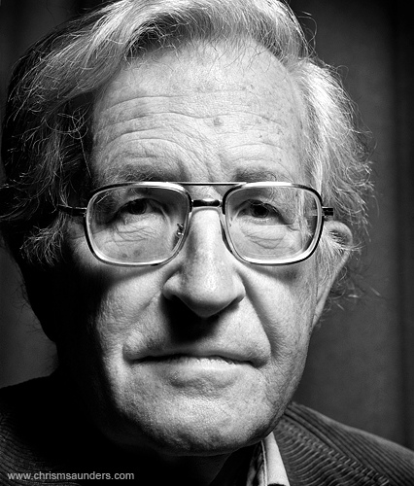
Inf. in English is weak while it is strong in French.
In English verb remains as VP. In French the verb has to rise to the I position to pick up tense and agreement within an Inflectional Phrase.
So, all learners have to do is set the parameter to either weak or strong on the basis of input.
According to Chomsky, a language is not , then , a system of rules , but a set of specifications for parameters in an invariant system of principles of Universal Grammar.

Slide 27
UG & L1
There is evidence from first language acquisition research that children have set the head parameter as early as two-word stage and they know how to project productively X categories into X’ categories in XP categories.
Ex: XP
Specifier X’ ( head element + complement)
(head element)X Complement

Slide 28
UG & L2
Second Language Learning is theoretically more complicated than L1 acquisition as many factors intervene the process such as;
L2 learners are cognitively mature
L2 learners already know at least one language
L2 learners have different motivations for learning a second language.
So, even if UG hypothesis is correct for L1 , there are still a number of logical possibilities concerning its role in L2.

Slide 29
Second Languages are not Universal Grammar –constrained
Second languages are not constrained by Universal Grammar principles and parameters and they do not behave like natural languages
Second Languages are Universal Grammar –constrained
Full access: The whole of Universal Grammar is avaliable to second language learners , in the same way as it is to first language learners.
Partial access: Some parts of Universal Grammar is not avaliable any longer. For ex: functional features that are not realized in the first language can not be acquired.

Slide 30
Hypothesis about Parameter Resetting
Children in early stages only have access to lexical categories and lack functional categories .
Hypothesis regarding L1 ;
The Continuity Hypothesis
Maturation Hypothesis
Structural- Building Approach
Debates on Initial Stage ( the subconcious linguistic representations second language learners have at the onset of SLL)

Slide 31
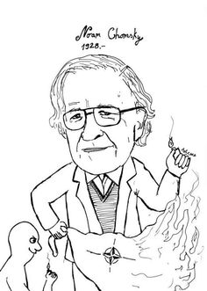
Which aspects of UG might be avaliable and which not?
Some contradictory facts about SLA process;
Learners do not seem to produce ‘ wild’ grammars , that is, grammars that would not be constrained by UG. Does that suggest that at least principles of UG are avaliable to them?
Learners produce grammars that are not necessarily like either their first language or their second language. Does this suggest that parameter settings other than those realized in their first and second languages are avaliable to them?
Some principles and parameters seem to be unproblematic to reset ; others more difficult , or even impossible. Why?

Slide 32
Hypothesis 1 : no access to Universal Grammar
Proponents of this hypothesis argue that there is a ‘ critical period’ for SLA and after puberty UG is no longer avaliable to SLLs.
A study with immigrant children;
Age of arrivals and grammatical properties were examined.
Result: The ones before seven performed native –like while others made more errors.
Opponents : it does not mean that adults grammars are not Universal Grammar –constrainted.

Slide 33
Hypothesis 2 : full access to Universal Grammar
1) Full access/ no transfer : Flynn ( 1996) claims that there is no such thing as a critical period. UG is accessible at initial stages of learning and parameter setting is done directly to L2 values.
  L2 acquisition is similar to L1 as learners can acquire principles and parameter settings which do not exist in their L1.
  Research 1: English speakers of Japanese can
  successfully reset the head-direction parameters
  ( from head- last to head-first)
  Research 2: Japanese could project Subjacency principle , wh-movement in English. ( Flynn)

Slide 34
2) Full transfer / full access: Proponents of this hypothesis believe that SLLs have full access to UG principles and parameters, whether or not they are present in the learners’ first language.
In this view , second language learners are thought to transfer all the parameter settings from their first language in an initial stage and revise their hypothesis when second language fails to conform these settings.

Slide 35
3) Full access / impaired early representations :
The supporters of this hypothesis believe that learners can reset parameters to the second language values , but initially learners are lacking functional categories.
(1996,98) Minimal Trees Approach: At initial stages only lexical categories are projected and functional categories develop later.
(1996) Valueless Features: Both lexical and functional categories are transfered from L1 but functional categories lack values such as tense , agreement..etc

Slide 36
Hypothesis 3 : Partial access
No parameter resetting :
Proponents of this hypothesis claim that learners only have access to UG via their first language.
SLA is unlike L1 acqusition.
They have already set parameters for their L1 and this is the basis for L2. Other principles and parameters are not avaliable to them. They will have to resort other mechanisims for different parameter settings.

Slide 37
Child Language Development
A. Universal Grammar
B. Domain-Specific learning processes
Adult Foreign language learning
A. Native language knowledge
B. General problem solving system
Biley-Vroman, 1989, p,51

Slide 38
Research: English learners of Korean speakers failed to recognize ‘ wh –movement’ in English. As , there is no ‘wh-movement’ in Korean so the subjacency principle is presumably not operative.
- contradict with the study of Flynn??? –
Schachter accepts that UG may be available for child second language learners, but argues there is a critical period that she calls as ‘ Window of Opportunity’.
Child Second Language learners pass through different Windows for different modules of the target language.

Slide 39
Impaired functional features: Second language grammars are Universal Grammar-constrained, but not all parameter settings will be available. SLL will try to accommodate the second language grammar within the settings they already have.
Modulated structure building: Hawkins & Chan argue that learners start with minimal trees that are lexical projections . Functional projections develop later. They argue that learners re-analyse the input to make it fit their first language setting.
Constructionism: It proposes that L2er uses a coalition of resources to construct L2 vocabulary and grammar; UG template, first language transfer, primary linguistic data, input and intake, instructional bootstrapping.

Slide 40
Today researches in this area have shifted from the initial question of the availability vs non-avaliability of Universal Grammar towards a more modular view. New studies are being conducted on testing the availability of sub-modules of UG rather than UG itself.

Slide 41
Evaluation of UG based on SLA
The scope and achievements of UG
UG is a linguistic theory , not a learning theory so tries to answer the question;
What constitutes knowledge of language ?
Influential in helping researches to draw up hypotheses.
Feed into a comprehensive second language acquisition theory

Slide 42
UG view of language
UG is only concerned with the sentence and internal structure of language. It treats language as being a mental object rather than a social and psychological one.
The theory is dealing with modelling linguistic competence , and the study of naturalistic performance is not seen as a suitable window into mental representations of language.
Lack of reliability is another concern in UG. Grammaticality judgement tests are often relied, hence drawing inferences about mental representations from such data remains doubtful.

Slide 43
UG view of language acqusition
UG based on approaches deal with syntax. Semantics, pragmatics and discourse are excluded.
UG approach has been concerned with explaining the nature of second language linguistic system. The social and psychological variabilities are ignored.

Slide 44
It has been a very useful tool for linguistic analysis,
enabling more researches , such as principled way of
language transfer, cross-linguistic influence and
principles and parameters.
UG is useful not only in establishing some facts about SLA but also explaining.

Slide 45
UG view of language learner
The assumption is all human beings are endowed with such a mind so variations between individuals are ignored.
Language is the object of the study itself , rather than on the speaker or learner as a social being.

Slide 46



